Slide 1


SPELLBINDERS
01
KDU-FOE
Smart
Automatic Window
RETROFIT, INTELLIGENT, AFFORDABLE.
SMART COMFORT. ZERO EFFORT
GENESIZ ’25
SPELLBINDERS

Slide 2



SPELLBINDERS
KDU-FOE
02
The
PROBLEM
Energy loss 😓→ HVAC overwork → higher bills💸
Open windows during rain 🌧️→ property damage
Poor airflow → discomfort, health impact
Windows cause energy loss, property damage, and discomfort.
Manual management = inconvenience + high costs.

Slide 3


Solution
SPELLBINDERS
03
KDU-FOE
Retrofit, sensor-driven device
Responds to weather & schedules
Affordable and accessible
3-PART VISUAL: 🧠 BRAIN (ESP32), 👂 SENSORS, 💪 MOTOR
ANIMATION ARROWS SHOWING SENSORS → ESP32 → MOTOR ACTION
How It Works: Smart Automatic Window
The Brain – ESP32
Low-cost, powerful microcontroller with built-in Wi-Fi
Handles decision-making & connectivity
The Senses – Sensors
Rain Sensor: Detects precipitation 🌧️
Temp/Humidity Sensor: Monitors climate 🌡️
Light Sensor: Measures sunlight intensity ☀️
The Muscle – DC Motor
High-torque, quiet motor
Opens/closes windows smoothly & reliably
The Interface – Software
Custom firmware integrated with Blynk IoT platform
Works with voice assistants for seamless control
System Overview
ESP32 processes sensor data → Commands motor → Accessible via app or voice
Robust yet simple tech stack for smart, automated comfort
SMART AUTOMATIC WINDOW: RETROFIT, INTELLIGENT, AFFORDABLE.
IT CLOSES WHEN IT RAINS, OPENS WHEN IT’S HOT, AND ADAPTS TO YOUR LIFE.

Slide 4



MARKET
SPELLBINDERS
04
KDU-FOE
PRIMARY CUSTOMERS: HOMEOWNERS (25–55), ECO-CONSCIOUS FAMILIES, MOBILITY-CHALLENGED INDIVIDUALS.
SECONDARY CUSTOMERS: SMART OFFICES, HOTELS, DEVELOPERS.
PRIMARY: HOMEOWNERS, ECO-CONSCIOUS FAMILIES, MOBILITY-CHALLENGED
SECONDARY: OFFICES, HOTELS, DEVELOPERS
GROWING SMART HOME MARKET

Slide 5
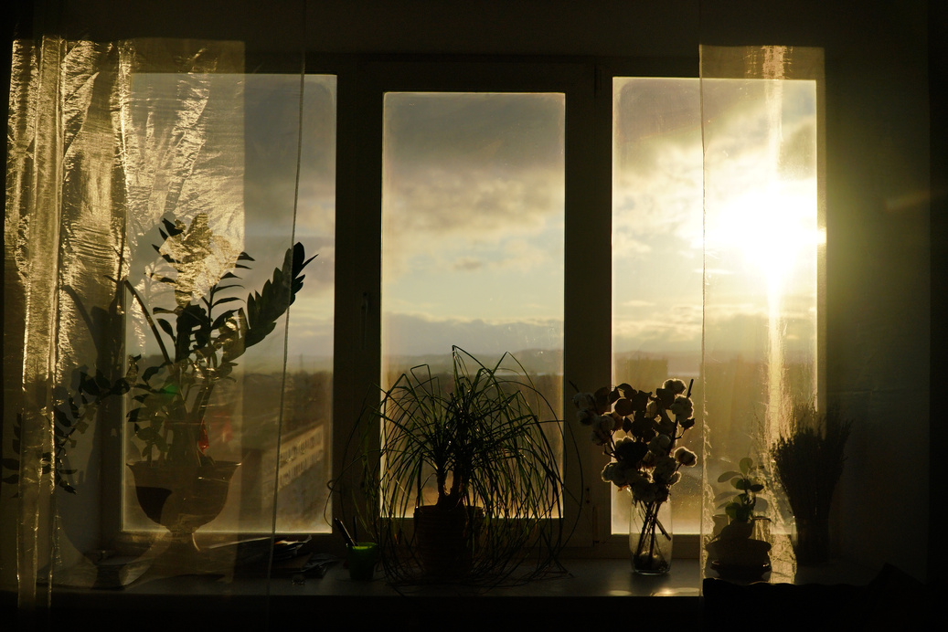
Product
SPELLBINDERS
05
KDU-FOE
Brain: ESP32 (decision + Wi-Fi)
Senses: Rain, Temp/Humidity, Light
Muscle: DC motor
Interface: App + Voice assistants
THE COMFORT COMPROMISE
Homes should be a place of comfort & relaxatiON 🏡
MANUAL WINDOWS OFTEN CREATE STUFFY, UNCOMFORTABLE ROOMS
POOR AIRFLOW IMPACTS SLEEP, FOCUS, AND OVERALL WELL-BEING
WE COMPROMISE COMFORT DAILY — OFTEN WITHOUT NOTICING

Slide 6



THE IMPACT
SPELLBINDERS
06
KDU-FOE
IMPACT OF SMART AUTOMATIC WINDOW
SOCIAL IMPACT 👵🧑‍🦽
RESTORES INDEPENDENCE FOR ELDERLY & DISABLED
ENHANCES HOME SECURITY
ENVIRONMENTAL IMPACT 🌍
REDUCES ENERGY USE FROM HVAC SYSTEMS
LOWERS CARBON FOOTPRINT & SUPPORTS SUSTAINABILITY
ECONOMIC IMPACT 💰
SAVES MONEY ON ENERGY BILLS
CREATES JOBS IN MANUFACTURING, SALES, TECH SUPPORT
MAKES SMART HOME TECH ACCESSIBLE TO MORE PEOPLE

Slide 7

SPELLBINDERS
07
KDU-FOE
Validation
PROTOTYPE & VALIDATION
FUNCTIONAL VALIDATION ✅
FULLY WORKING PROTOTYPE TESTED
CORE FEATURES VALIDATED:
RAIN RESPONSE 🌧️
TEMPERATURE-BASED CONTROL 🌡️
SCHEDULING ⏰
APP INTEGRATION 📱
COST-EFFECTIVE ENGINEERING 💰
BUILT USING OFF-THE-SHELF COMPONENTS
TOTAL COST: LKR 13,880
CONFIRMS OUR AFFORDABLE, PRACTICAL MODEL
KEY IDEA
NOT JUST A CONCEPT — A PROVEN, WORKING SOLUTION
WORKING PROTOTYPE TESTED: RAIN RESPONSE, TEMP CONTROL, SCHEDULING, APP INTEGRATION.
BUILT UNDER LKR 14,000 – PROVING AFFORDABILITY.

Slide 8

COMPETITION
SPELLBINDERS
08
KDU-FOE
Feature | Smart Automatic Window | High-End Competitors | Basic Competitors
Price | Affordable (~LKR 16k) | Very Expensive (>LKR 80k) | Affordable
Installation | Easy Retrofit | Professional, Complex | Simple
Rain Sensor | Yes | Sometimes | No
Temp Sensor | Yes | Sometimes | No
Scheduling | Yes | Yes | No
True Automation | Yes | Yes | No

Slide 9

Financial Projections
SPELLBINDERS
09
KDU-FOE
THE DEVICE AFFORDABLE AND ACCESSIBLE FOR FAMILIES
REVENUE WILL COME FROM TWO STREAMS:
DIRECT HARDWARE SALES, AND A PREMIUM SAAS SUBSCRIPTION
OUR PROTOTYPE WAS BUILT AT ~LKR 14,000 MANUFACTURING, THE MARKET-READY PRICE WILL BE ~LKR 16,000.
SOLAR-POWERED VERSION, MAKING OUR PRODUCT COMPLETELY ENERGY INDEPENDENT AND EVEN MORE ECO-FRIENDLY.
SCALE HARDWARE SALES FOR MARKET PENETRATION, THEN GROW RECURRING INCOME FROM POWER USERS

Slide 10
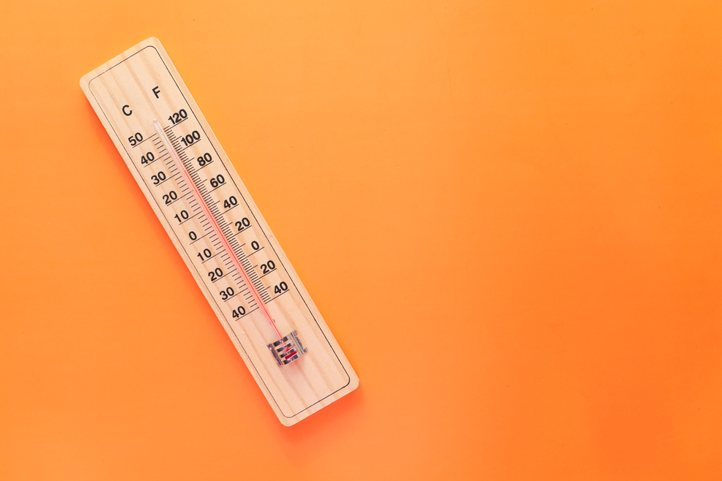

FULL ENVIRONMENTAL AWARENESS
SPELLBINDERS
10
KDU-FOE
SMART AUTOMATIC WINDOW IN ACTION
RAIN? 🌧️ CLOSED
FIRST DROP DETECTED → WINDOW CLOSES → PREVENTS WATER DAMAGE
TOO HOT? 🌡️ OPEN
INDOOR TEMPERATURE EXCEEDS USER-SET THRESHOLD → WINDOW OPENS → VENTS HOT AIR & EASES AC LOAD
PERFECT WEATHER? 🌿 OPEN
IDEAL CONDITIONS → NATURALLY VENTILATES & COOLS YOUR HOME
ALWAYS WORKING
ACTS AS A GUARDIAN FOR YOUR HOME
MONITORS ENVIRONMENT CONTINUOUSLY → MAINTAINS OPTIMAL COMFORT AUTOMATICALLY

Slide 11
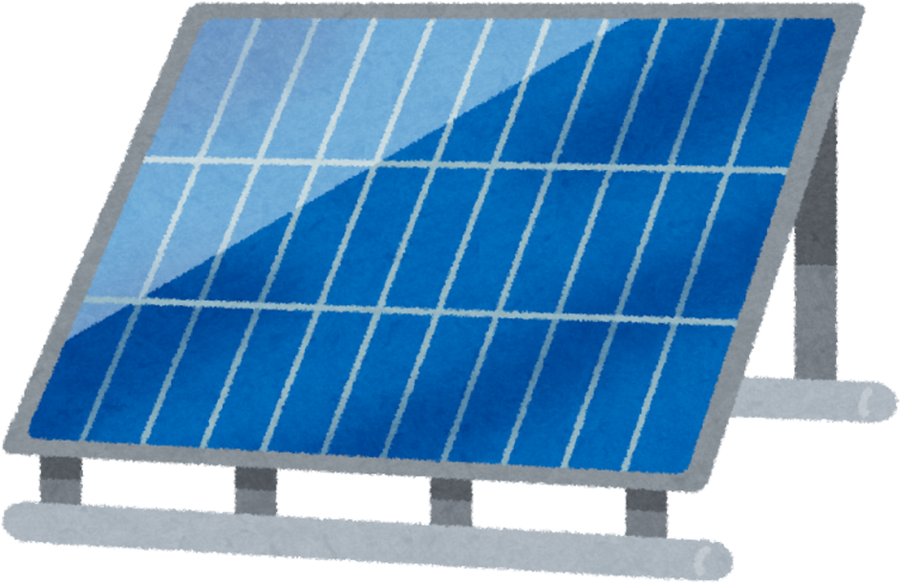


SPELLBINDERS
ROADMAP TO THE FUTURE
11
KDU-FOE
ROADMAP & FUTURE PLANS
PHASE 1: PROOF OF CONCEPT ✅
FUNCTIONAL PROTOTYPE BUILT & TESTED
PHASE 2: PILOT & REFINE (NEXT 6 MONTHS)
DEPLOY PROTOTYPES IN HOMES FOR TESTING
GATHER FEEDBACK & FINALIZE DESIGN
PHASE 3: MARKET LAUNCH (NEXT 12 MONTHS)
START SMALL-SCALE PRODUCTION
LAUNCH DIRECT-TO-CONSUMER ONLINE
FUTURE PLANS
INTEGRATE AIR QUALITY SENSORS (PM2.5, CO2)
DEVELOP SOLAR-POWERED VERSIONS
IMPLEMENT AI FOR PREDICTIVE CLIMATE CONTROL
THE VISION
AN AUTONOMOUS, ECO-FRIENDLY, AI-DRIVEN LIVING SOLUTION THAT TRANSFORMS EVERYDAY SPACES INTO INTELLIGENT ENVIRONMENTS.

Slide 12
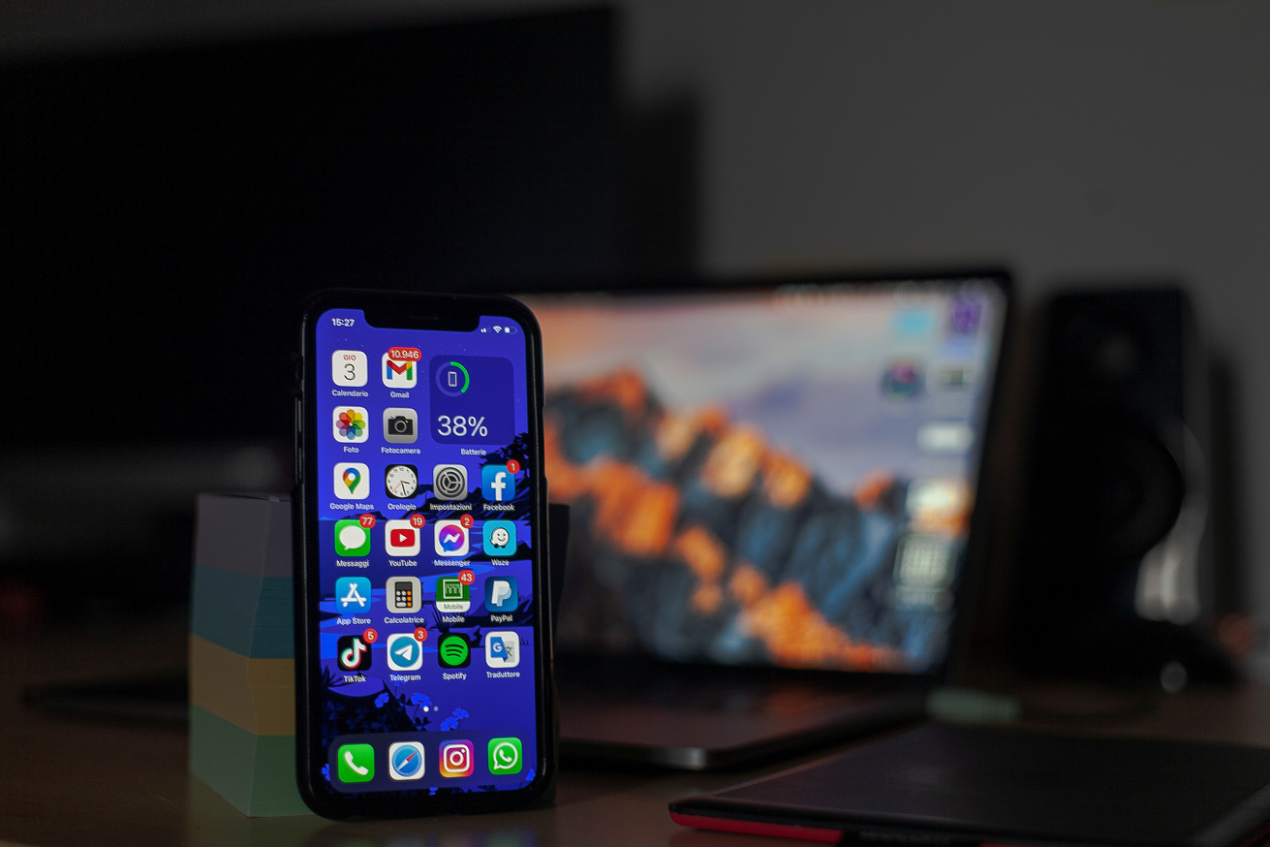

TOTAL CONTROL, ANYWHERE
SPELLBINDERS
121
KDU-FOE
SEAMLESS CONTROL & FLEXIBILITY
MOBILE APP 📱
FULL CONTROL & STATUS UPDATES FROM ANYWHERE
NOTIFICATIONS FOR EVENTS (E.G., RAIN → WINDOW CLOSES)
VOICE CONTROL 🗣️
INTEGRATED WITH GOOGLE ASSISTANT & AMAZON ALEXA
HANDS-FREE COMMANDS LIKE “CLOSE THE LIVING ROOM WINDOW
FLEXIBILITY ⚡
AUTOMATION HANDLES 95% OF SITUATIONS
ALWAYS OVERRIDE OR ADJUST VIA APP OR VOICE, AT HOME OR ON VACATION
KEY IDEA
EVEN WITH AUTOMATION, YOU REMAIN IN FULL CONTROL

Slide 13

SPELLBINDERS
18
KDU-FOE
THANK YOU & Q&A
THANK YOU FOR YOUR TIME.
TEAM SPELLBINDERS

